Slide 1
Chapter 21 Carboxylic Acid Derivatives: Nucleophilic Acyl Substitution Reactions

Slide 2
Learning Objectives
(21.1)
Naming carboxylic acid derivatives
(21.2)
Nucleophilic acyl substitution reactions
(21.3)
Reactions of carboxylic acids
(21.4)
Chemistry of acid halides

Slide 3
Learning Objectives
(21.5)
Chemistry of acid anhydrides
(21.6)
Chemistry of esters
(21.7)
Chemistry of amides

Slide 4
Learning Objectives
(21.8)
Chemistry of thioesters and acyl phosphates: Biological carboxylic acid derivatives
(21.9)
Polyamides and polyesters: Step-growth polymers
(21.10)
Spectroscopy of carboxylic acid derivatives

Slide 5
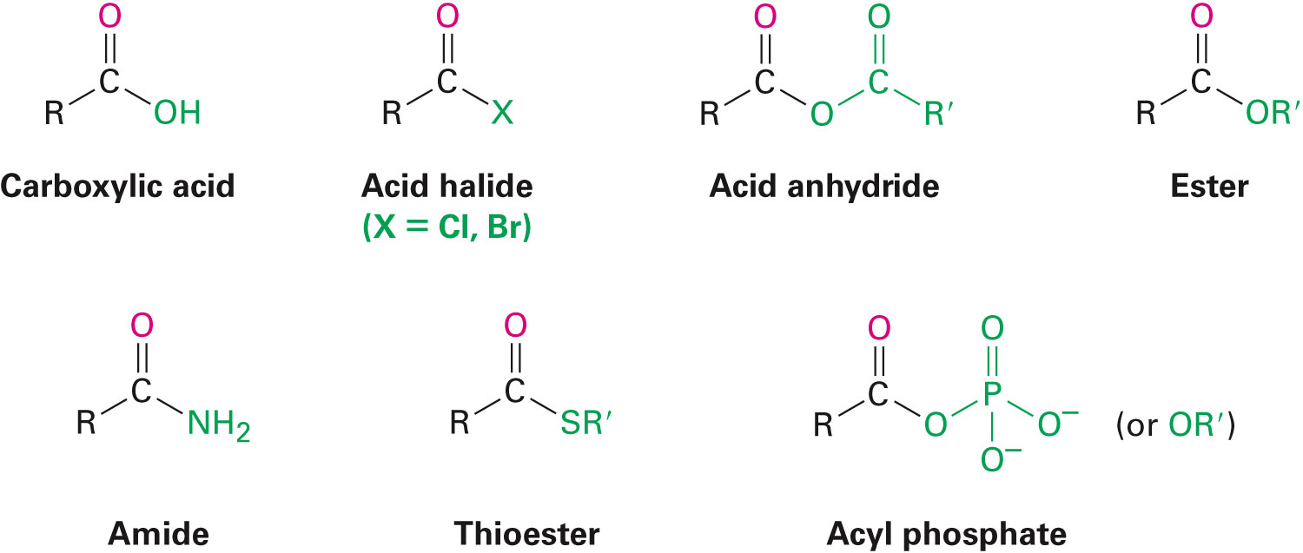
Carboxylic Compounds

Slide 6
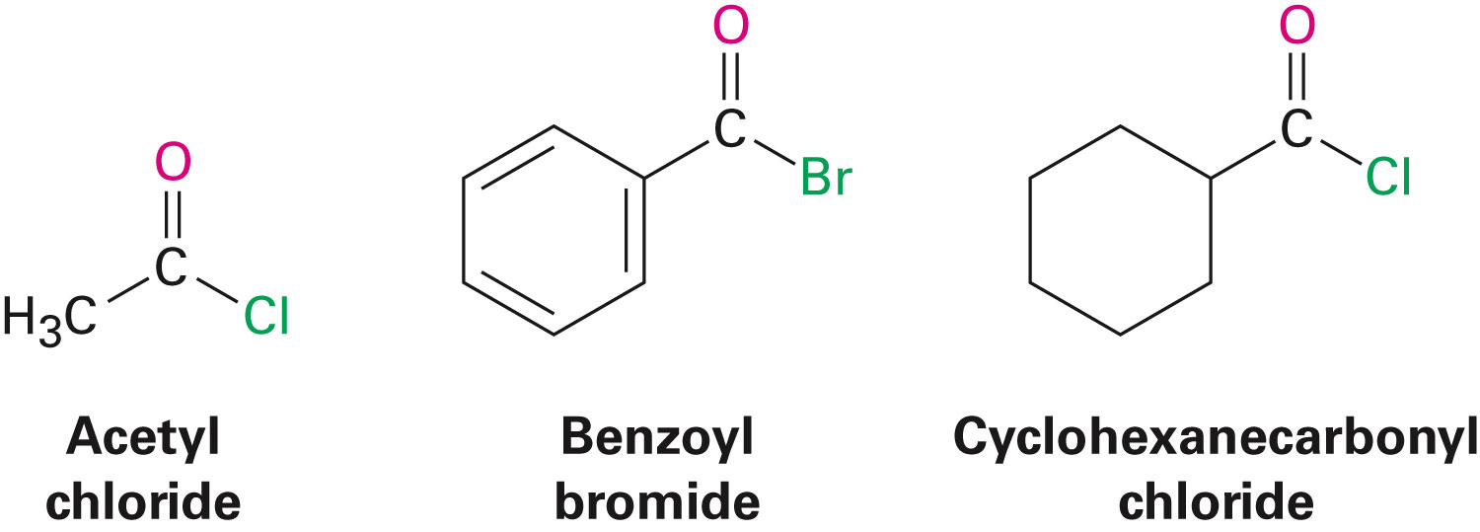
Naming Carboxylic Acid Derivatives
Acid halides, RCOX
Derived from carboxylic acid name by replacing the –ic acid or –oic acid ending with –oyl or –carboxylic acid ending with –carbonyl
Notes:
Naming carboxylic acid derivatives

Slide 7
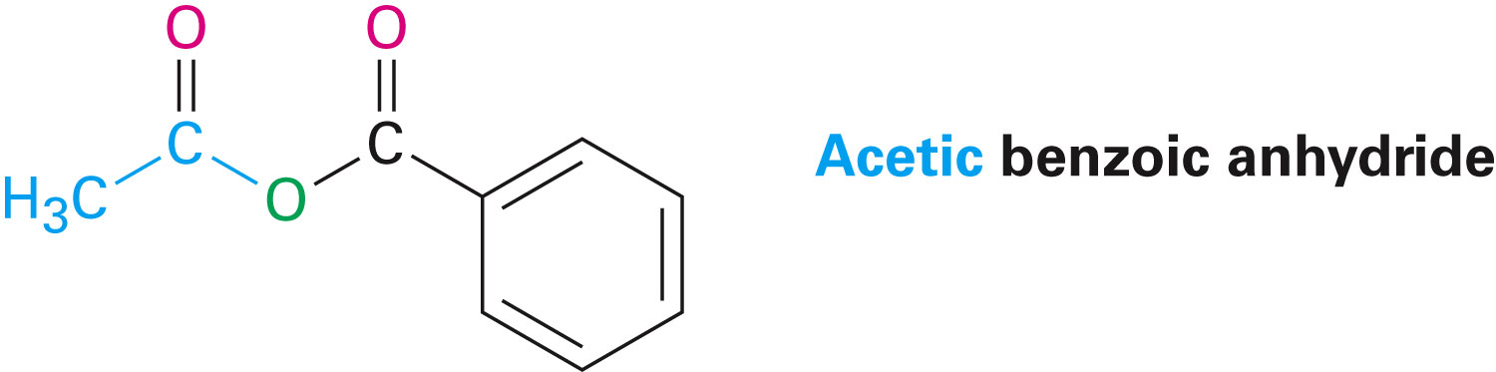
Naming Carboxylic Acid Derivatives
Acid anhydrides, RCO₂COR’
Symmetrical anhydrides of unsubstituted monocarboxylic acids and cyclic anhydrides of dicarboxylic acids, replacing acid with anhydride
Unsymmetrical anhydrides, listing the two acids alphabetically and then adding anhydride
Notes:
Naming carboxylic acid derivatives

Slide 8
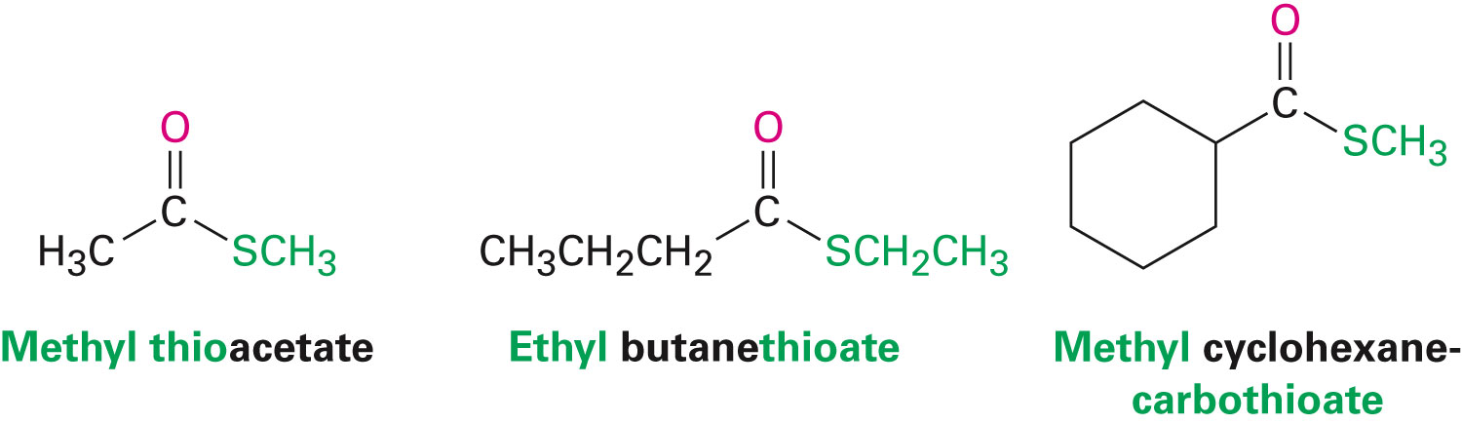
Naming Carboxylic Acid Derivatives
Esters, RCO₂R’
Identifying alkyl group attached to oxygen and the carboxylic acid, replacing –ic acid with –ate
Notes:
Naming carboxylic acid derivatives

Slide 9
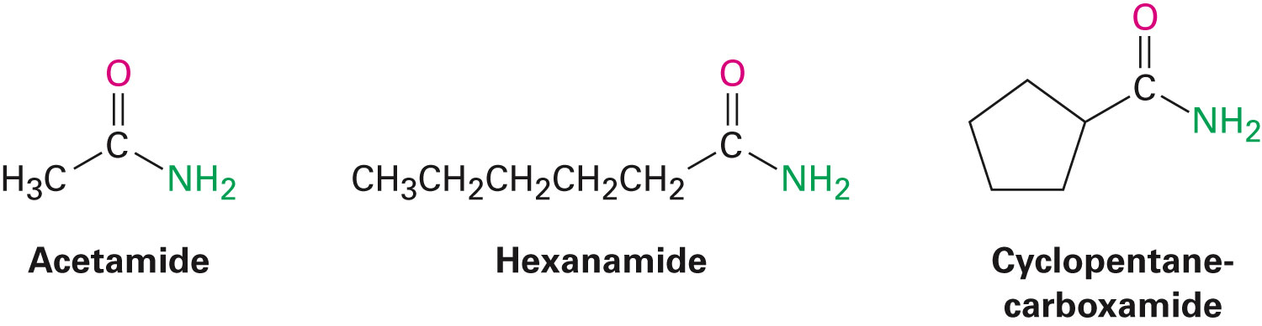
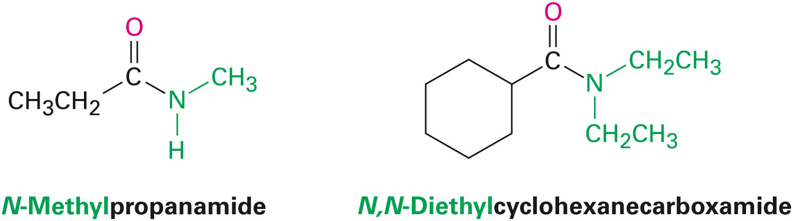
Naming Carboxylic Acid Derivatives
Amides, RCONH₂
With unsubstituted –NH2 group, –oic acid or –ic acid is replaced with –amide
–carboxylic acid ending is replaced with –carboxamide
If the N is further substituted, identify the substituent groups and then the parent amide
Notes:
Naming carboxylic acid derivatives

Slide 10

Naming Carboxylic Acid Derivatives
Thioesters, RCOSR’
Names similar to the corresponding esters
Prefix thio- is added to carboxylate if ester has a common name
–oate or carboxylate is replaced by –thioate or carbothioate if ester has a systematic name
Notes:
Naming carboxylic acid derivatives

Slide 11
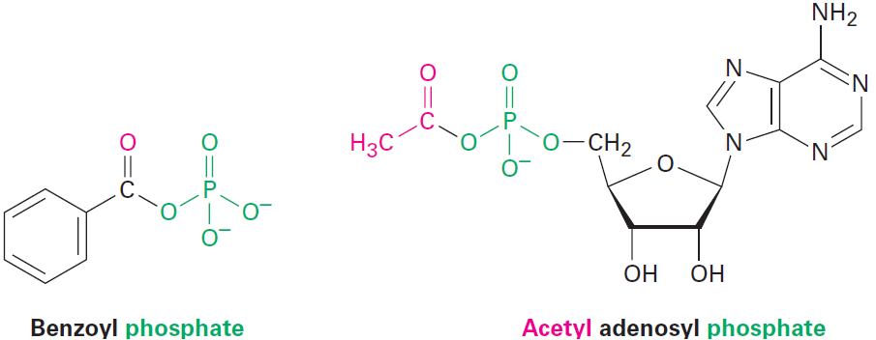
Naming Carboxylic Acid Derivatives
Acyl phosphates, RCO₂PO₃²⁻ and RCO₂PO₃R’–
Named by citing the acyl group and adding the word phosphate
Identified after acyl group, if an alkyl is attached to the phosphate oxygen
Notes:
Naming carboxylic acid derivatives

Slide 12
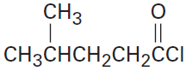
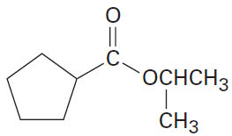
Worked Example
Draw structures corresponding to the following names:
a) 4-Methylpentanoyl chloride
b) Isopropyl cyclopentanecarboxylate
Solution:
a)
b)
Notes:
Naming carboxylic acid derivatives

Slide 13
Nucleophilic Acyl Substitution Reactions
Tetrahedral intermediate eliminates one of the two substituents originally bonded to the carbonyl carbon
Leads to a net nucleophilic acyl substitution reaction
Carboxylic acid derivatives have an acyl carbon bonded to a group –Y that can leave
Notes:
Nucleophilic acyl substitution reactions

Slide 14
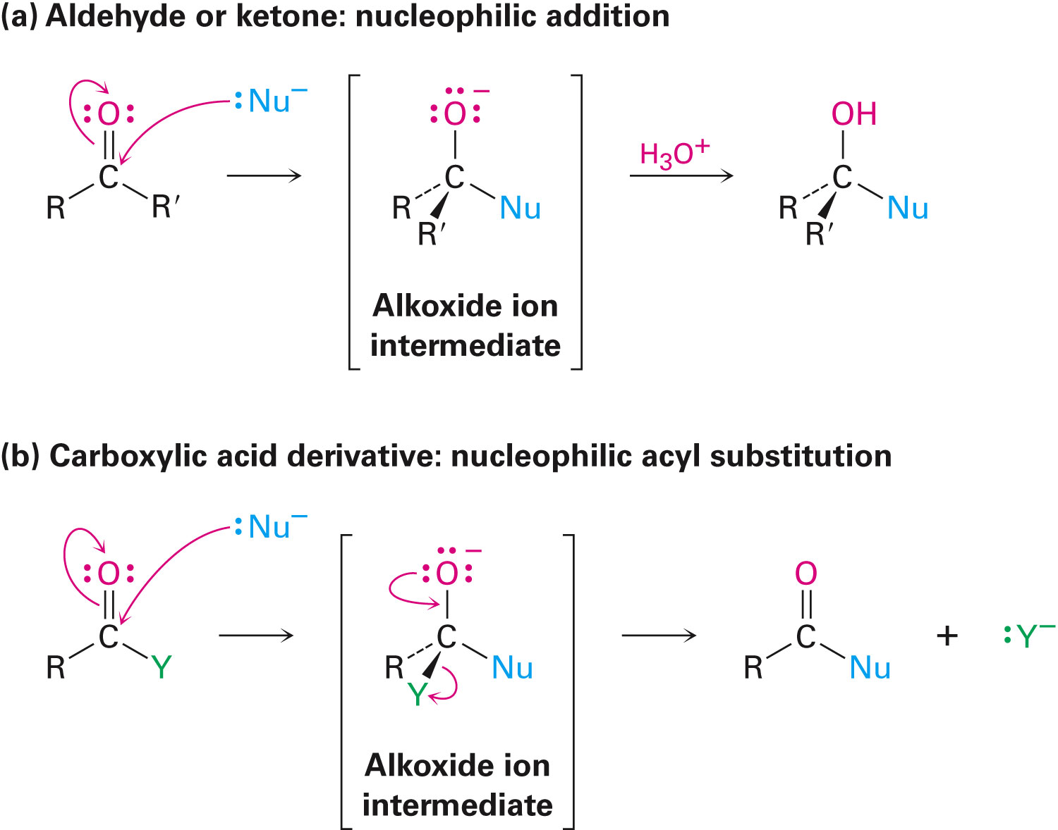
Figure 21.1 - The General Mechanisms of Nucleophilic Addition and Nucleophilic Acyl Substitution Reactions
Notes:
Nucleophilic acyl substitution reactions

Slide 15
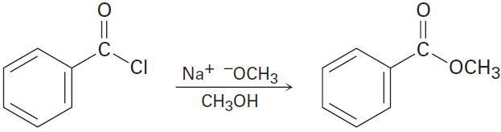
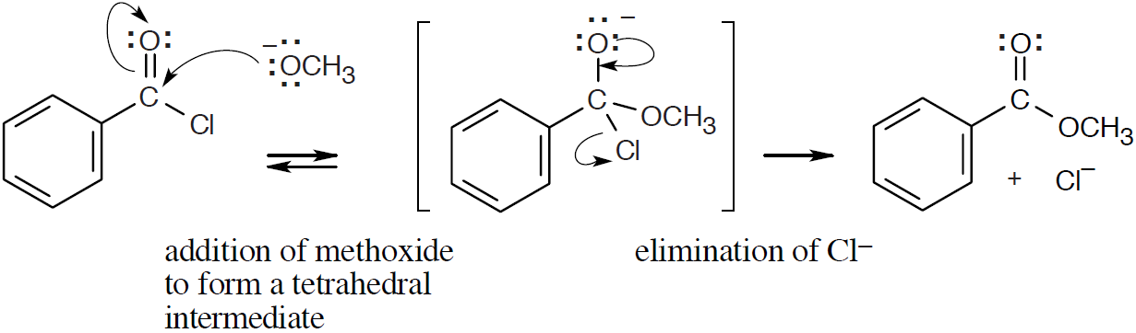
Worked Example
Show the mechanism of the following nucleophilic acyl substitution reaction
Use curved arrows to indicate the electron flow in each step
Solution:
Notes:
Nucleophilic acyl substitution reactions

Slide 16
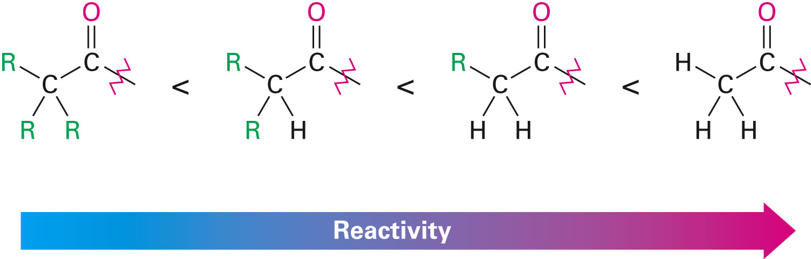
Nucleophilic Acyl Substitution Reactions
Relative reactivity of carboxylic acid derivatives
Nucleophiles react more readily with unhindered carbonyl groups
Electrophilic carbonyl groups are more reactive to addition
The intermediate with the best leaving group decomposes fastest
Notes:
Nucleophilic acyl substitution reactions

Slide 17
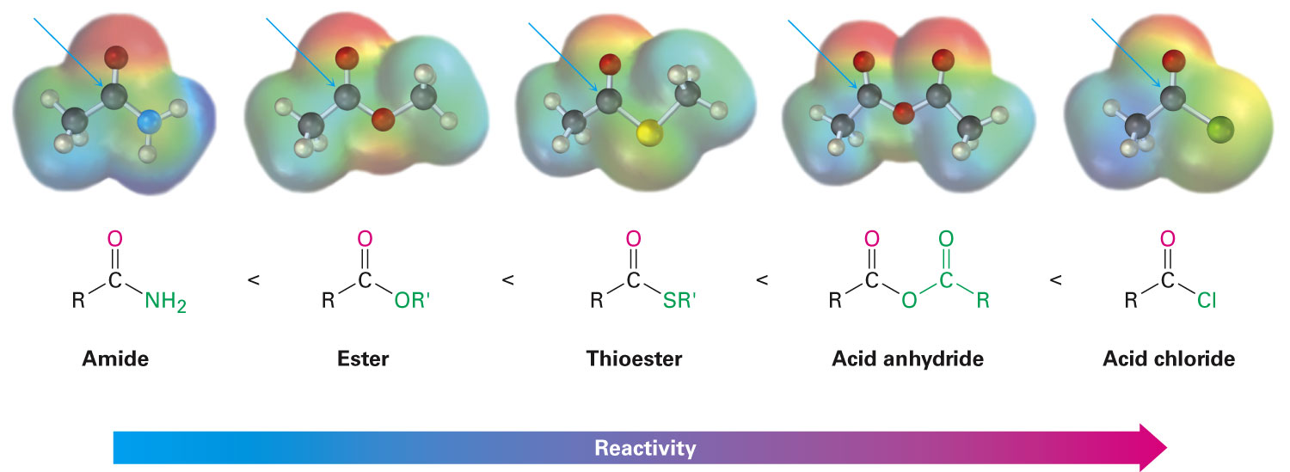
Nucleophilic Acyl Substitution Reactions
Various substituents affect the polarization of a carbonyl group
Similar to the way they effect reactivity of an aromatic ring toward electrophilic substitution
Notes:
Nucleophilic acyl substitution reactions

Slide 18
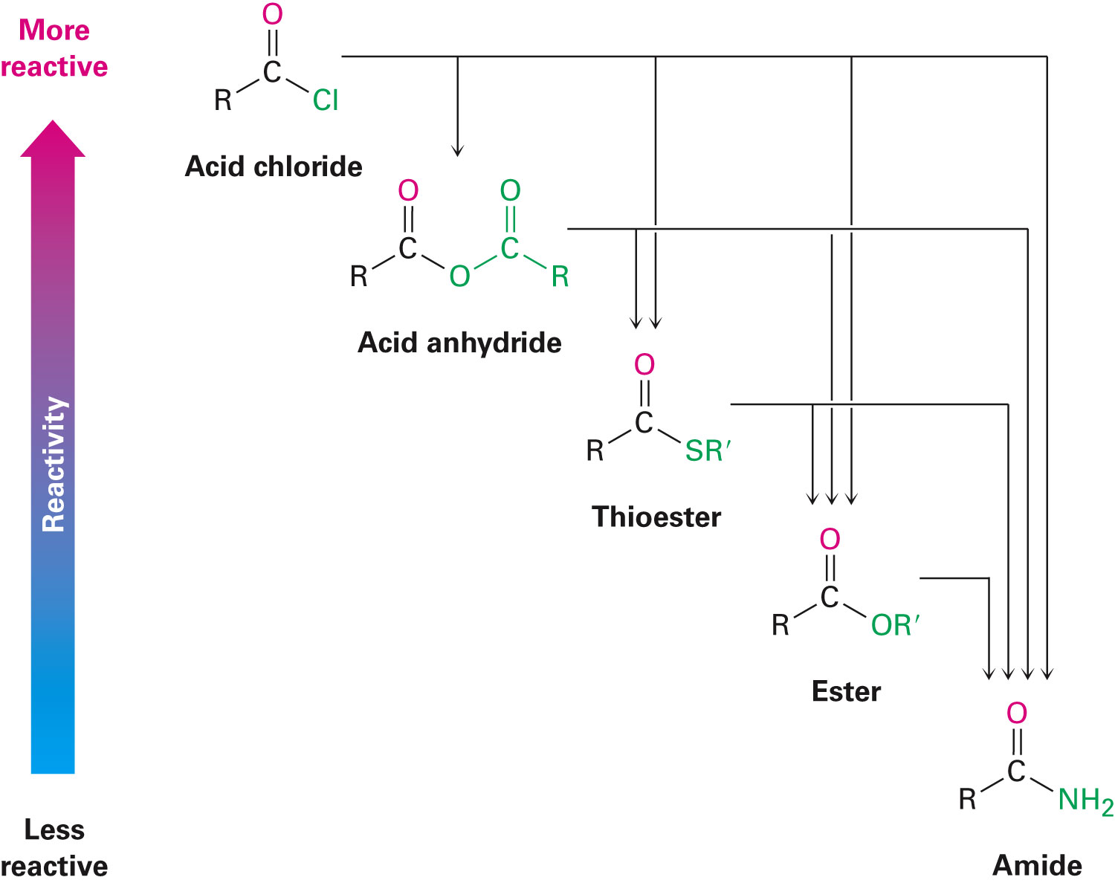
Nucleophilic Acyl Substitution Reactions
A more reactive acid derivative can be converted into a less reactive one
Acid halides and acid anhydrides react rapidly with water
Notes:
Nucleophilic acyl substitution reactions

Slide 19
Nucleophilic Acyl Substitution Reactions
Hydrolysis - Water is used as a reagent to make carboxylic acids
Alcoholysis – Alcohol is used as reagent to make esters
Aminolysis - Ammonia or an amine is used to make an amide
Reduction - Hydride source is used to make an aldehyde or an alcohol
Grignard reaction - Organometallic reagent is used to make a ketone or an alcohol
Notes:
Nucleophilic acyl substitution reactions

Slide 20
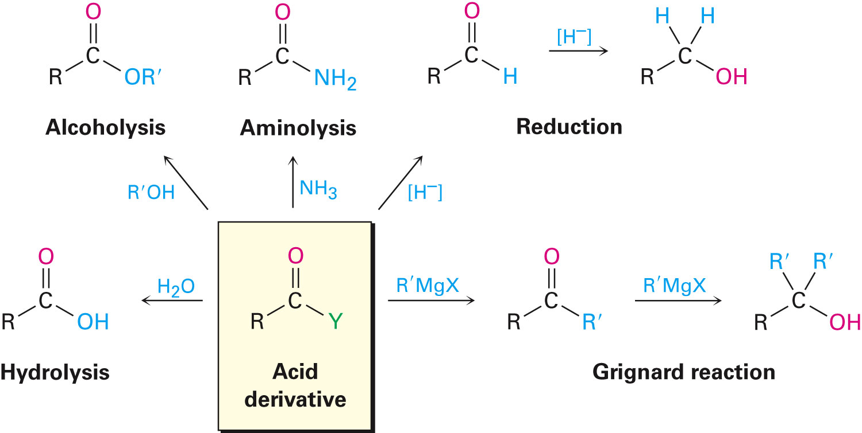
Figure 21.3 - Some General Reactions of Carboxylic Acid Derivatives
Notes:
Nucleophilic acyl substitution reactions

Slide 21
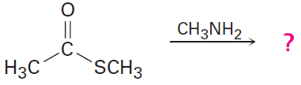
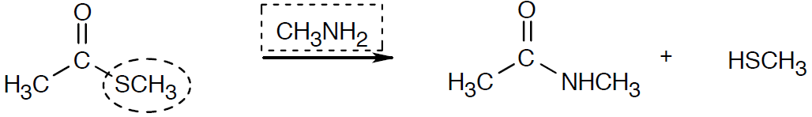
Worked Example
Predict the products of the following nucleophilic acyl substitution reaction
Solution:
Identifying the nucleophile and the leaving group and replacing the leaving group by the nucleophile in the product
Notes:
Nucleophilic acyl substitution reactions

Slide 22
Reactions of Carboxylic Acids
–OH is a poor leaving group
Direct nucleophilic acyl substitution of a carboxylic acid is difficult
Reactivity of the acid can be increased by:
Using a strong acid catalyst to protonate the carboxyl
Converting –OH into a better leaving group
Specific reagents such as acid chlorides, anhydrides, esters, and amides can be prepared from carboxylic acids
Notes:
Reactions of carboxylic acids

Slide 23
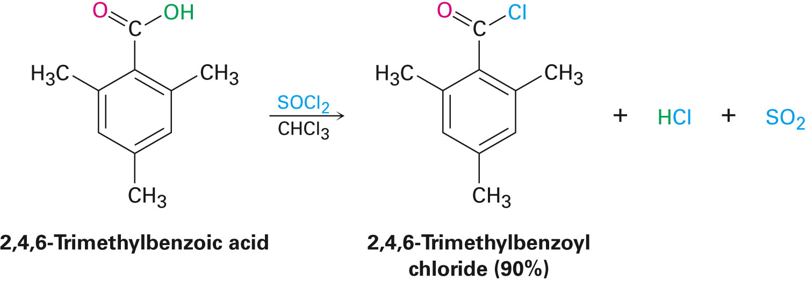
Reactions of Carboxylic Acids
Conversion of carboxylic acids into acid chlorides
Reaction with thionyl chloride, SOCl₂
Carboxylic acid is first converted into an acyl chlorosulfite intermediate which replaces the –OH of the acid with a much better leaving group
Chlorosulfite then reacts with a nucleophilic chloride ion
Notes:
Reactions of carboxylic acids

Slide 24
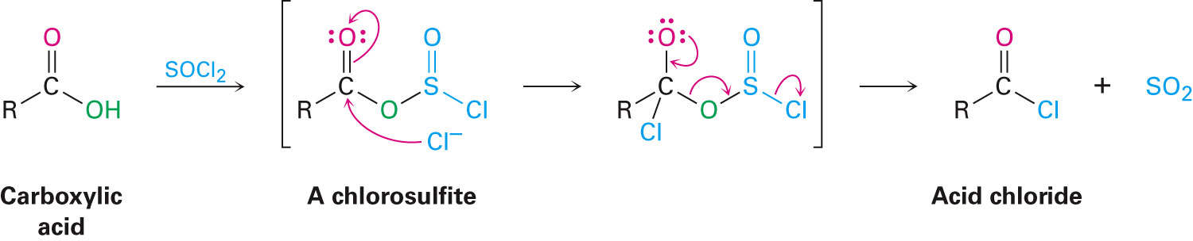
Reactions of Carboxylic Acids
Occurs by a nucleophilic acyl substitution pathway
Carboxylic acid is converted into a chlorosulfite which then reacts with chloride
Notes:
Reactions of carboxylic acids

Slide 25
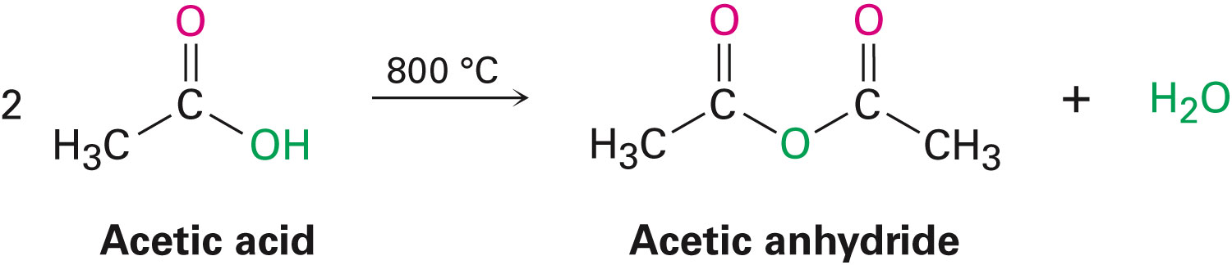
Reactions of Carboxylic Acids
Conversion of carboxylic acids into acid anhydrides
Acid anhydrides can be derived from two molecules of carboxylic acid by heating to remove water
Notes:
Reactions of carboxylic acids

Slide 26
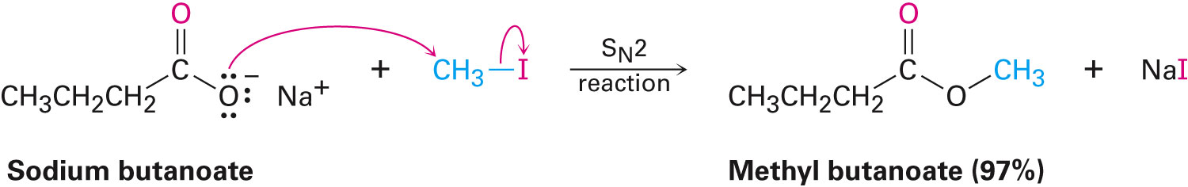
Reactions of Carboxylic Acids
Conversion of carboxylic acids into esters
Through reaction of a carboxylate anion with a primary alkyl halide
Notes:
Reactions of carboxylic acids

Slide 27
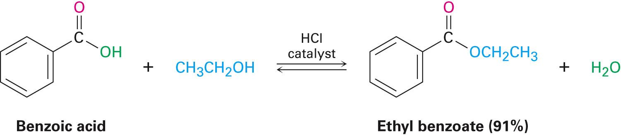
Reactions of Carboxylic Acids
Fischer esterification reaction: Synthesis of esters by an acid-catalyzed nucleophilic acyl substitution reaction of a carboxylic acid with an alcohol
Notes:
Reactions of carboxylic acids

Slide 28
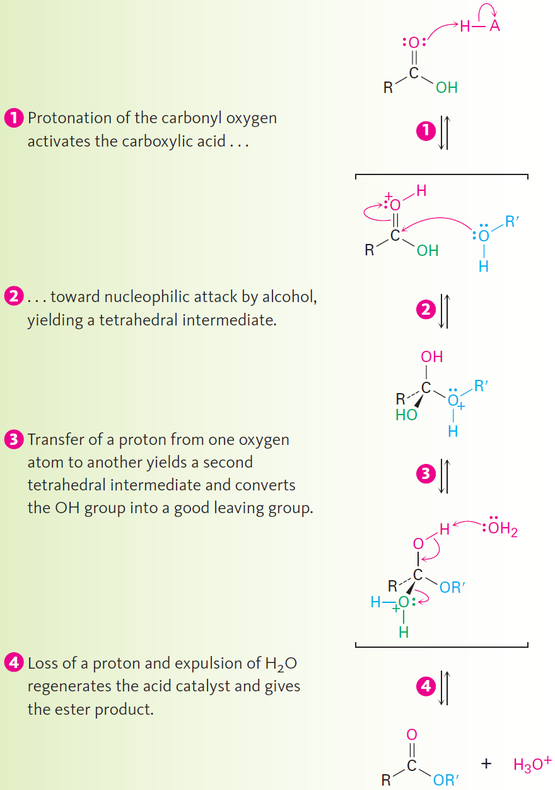
Mechanism of the Fischer Esterification
¹⁸O-labeled methanol reacts with benzoic acid, the methyl benzoate produced is ¹⁸O-labeled but the water produced is unlabeled
Notes:
Reactions of carboxylic acids

Slide 29
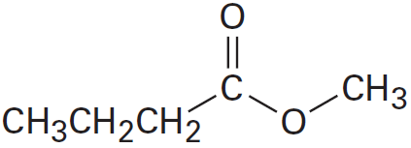
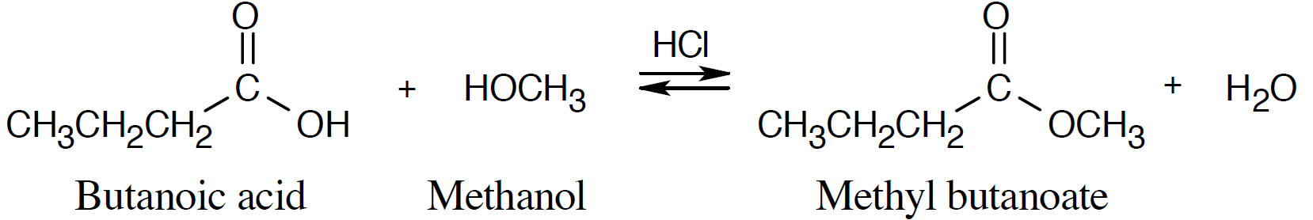
Worked Example
How is the following ester prepared from the corresponding acid?
Solution:
Notes:
Reactions of carboxylic acids

Slide 30
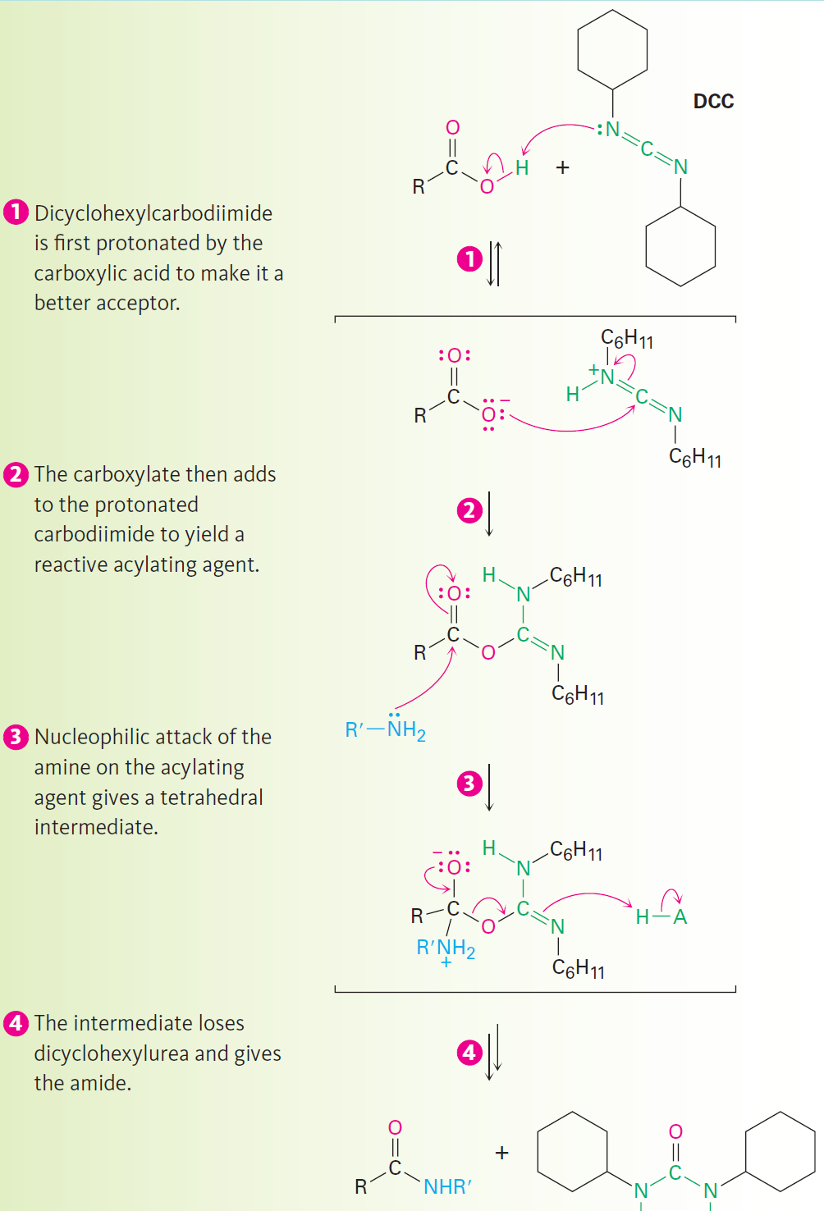
Reactions of Carboxylic Acids
Conversion of carboxylic acids into amides
Difficult to prepare by direct reaction of carboxylic acids
Prepared by activating the carboxylic acid with dicyclohexylcarbodiimde, followed by addition of the amine
Notes:
Reactions of carboxylic acids

Slide 31
Reactions of Carboxylic Acids
Conversion of carboxylic acids into alcohols
Carboxylic acids are reduced by LiAlH₄ to give primary alcohols
Reduction is a nucleophilic acyl substitution reaction in which –H replaces –OH to give an aldehyde
Reduces primary alcohol by nucleophilic addition
Notes:
Reactions of carboxylic acids

Slide 32
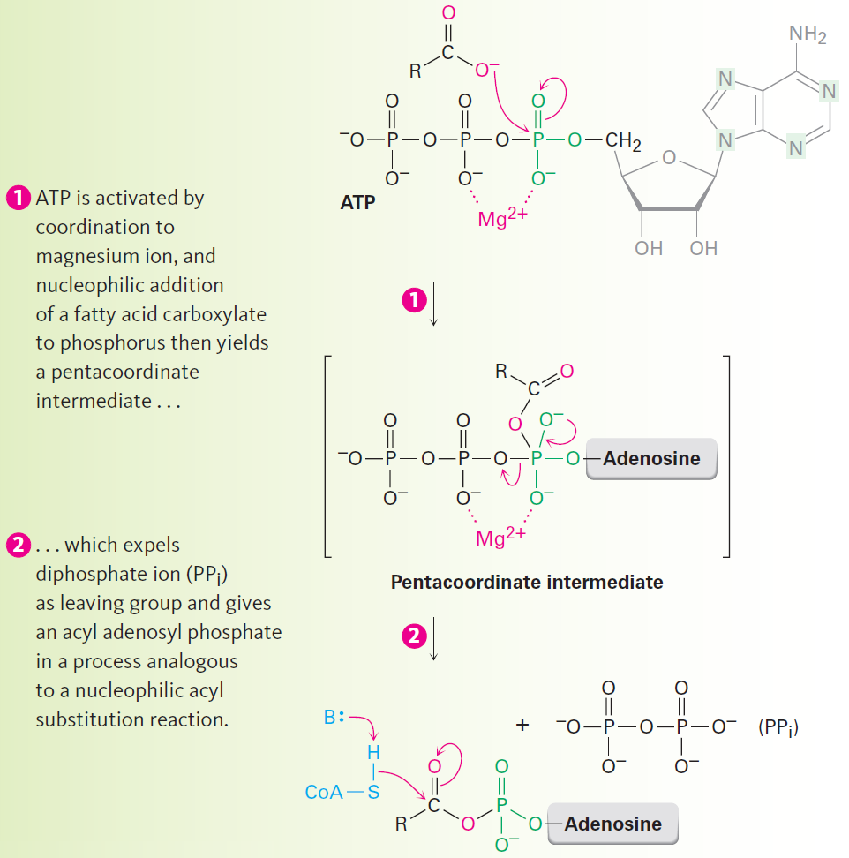
Reactions of Carboxylic Acids
Biological conversions of carboxylic acids
Direct conversions do not occur
In the laboratory, the acid must first be activated by converting the –OH into a better leaving group
Notes:
Reactions of carboxylic acids

Slide 33
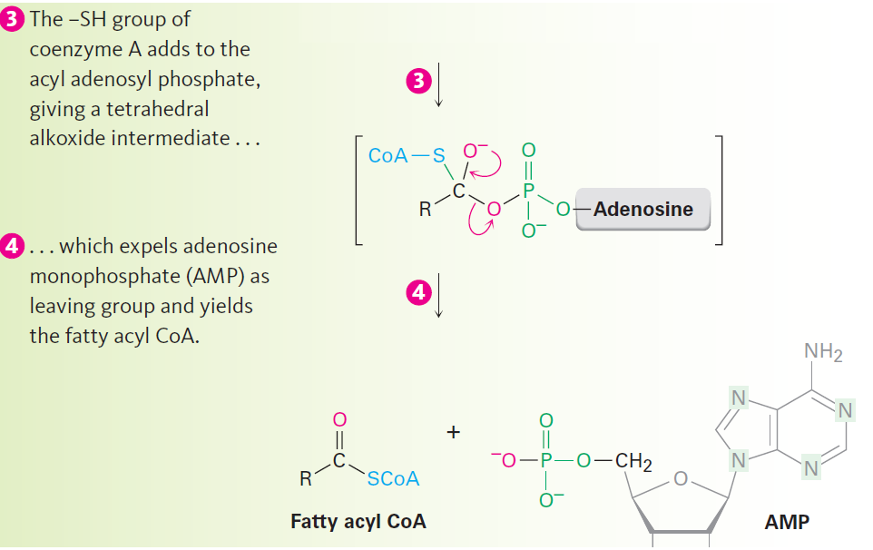
Reactions of Carboxylic Acids
Reaction of the carboxylate with ATP to give an acyl adenylate a nucleophilic acyl substitution on phosphorus
Notes:
Reactions of carboxylic acids

Slide 34
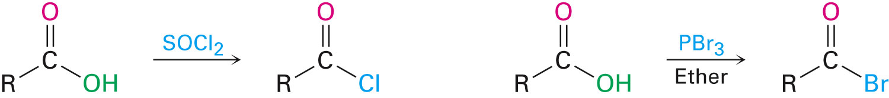
Chemistry of Acid Halides
Preparation of acid halides
Acid chlorides are prepared from carboxylic acids by reaction with SOCl₂
Reaction of a carboxylic acid with PBr₃ yields the acid bromide
Notes:
Chemistry of acid halides

Slide 35
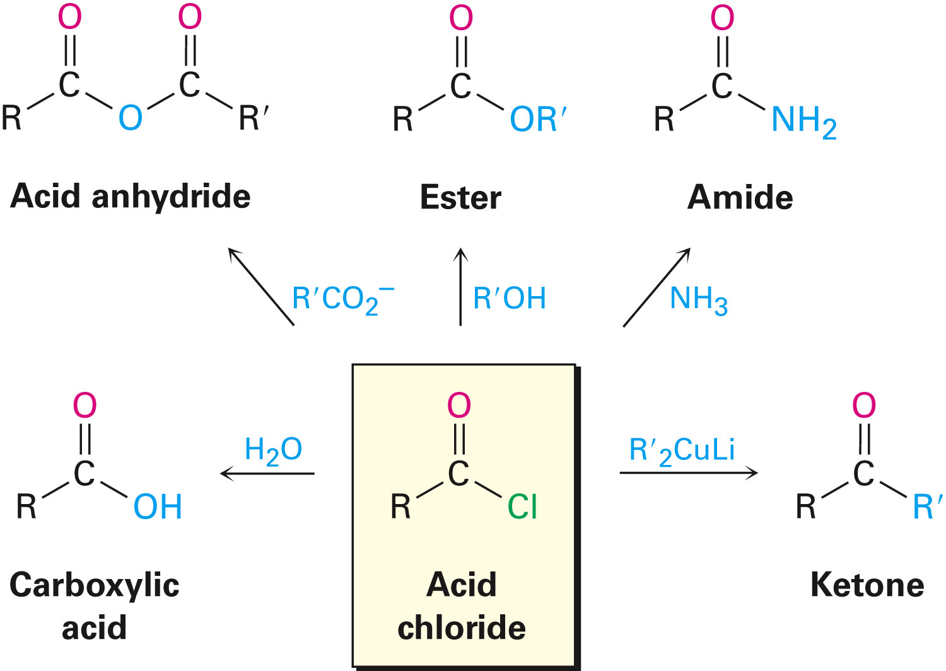
Chemistry of Acid Halides
Reaction of acid halides
Nucleophilic acyl substitution mechanisms
Halogen replaced by –OH, by –OR, or by –NH₂
Reduction yields a primary alcohol
Grignard reagent yields a tertiary alcohol
Notes:
Chemistry of acid halides

Slide 36
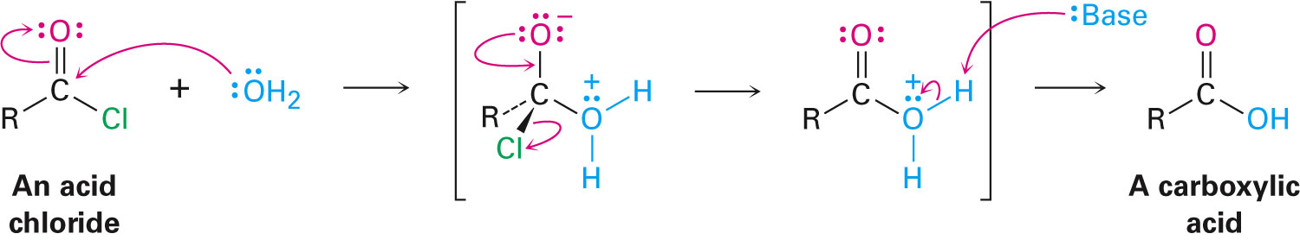
Chemistry of Acid Halides
Conversion of acid halides into acids: Hydrolysis
Acid chlorides react with water to yield carboxylic acids
HCl is generated during the hydrolysis: A base is added to remove the HCl
Notes:
Chemistry of acid halides

Slide 37
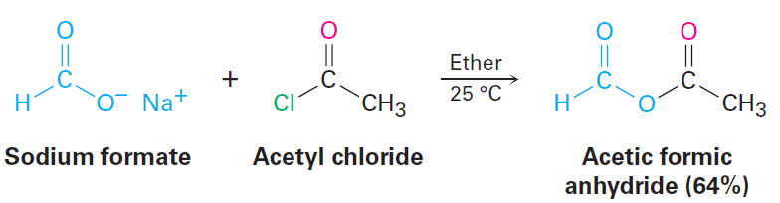
Chemistry of Acid Halides
Conversion of acid halides into anhydrides
Nucleophilic acyl substitution reaction of acid chloride with a carboxylate anion gives acid anhydride
Notes:
Chemistry of acid halides

Slide 38
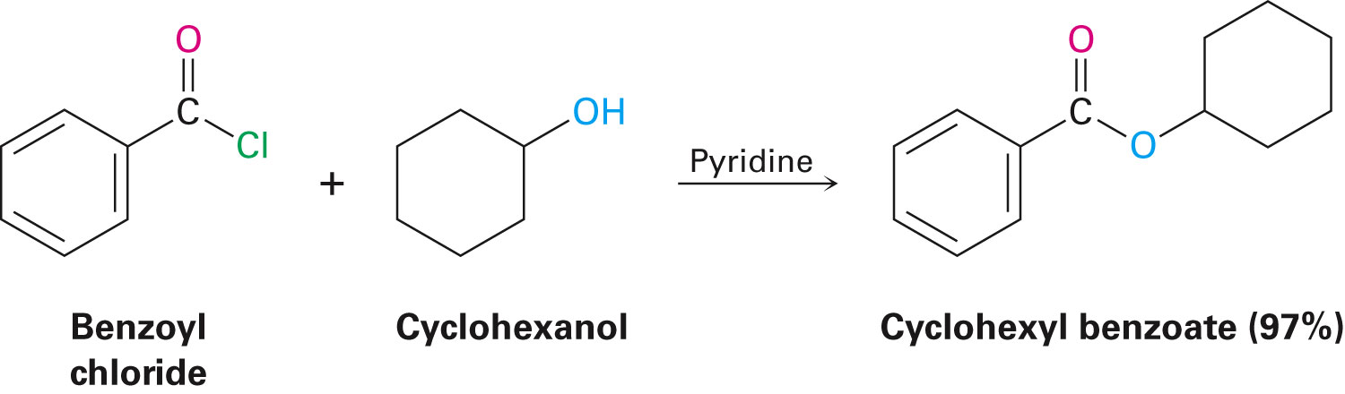
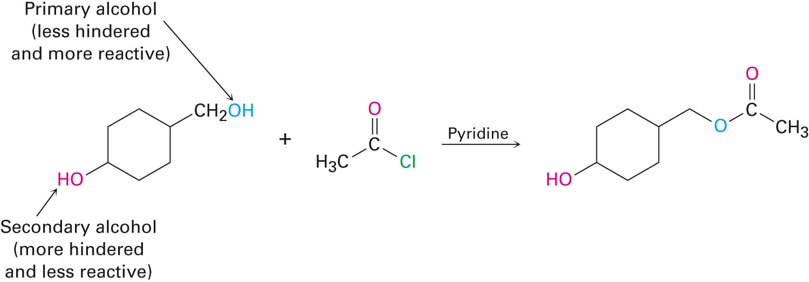
Chemistry of Acid Halides
Conversion of acid halides into esters: Alcoholysis
Esters are produced in the reaction of acid chlorides with alcohols in the presence of pyridine or NaOH
Notes:
Chemistry of acid halides

Slide 39
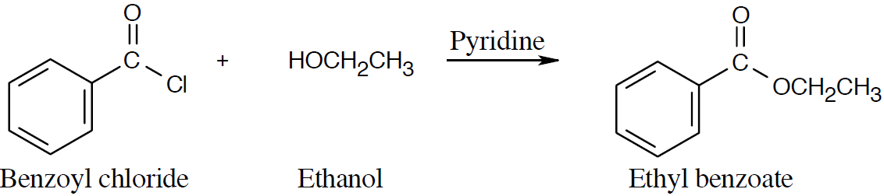
Worked Example
How is ethyl benzoate prepared using a nucleophilic acyl substitution reaction of an acid chloride
Solution:
Notes:
Chemistry of acid halides

Slide 40
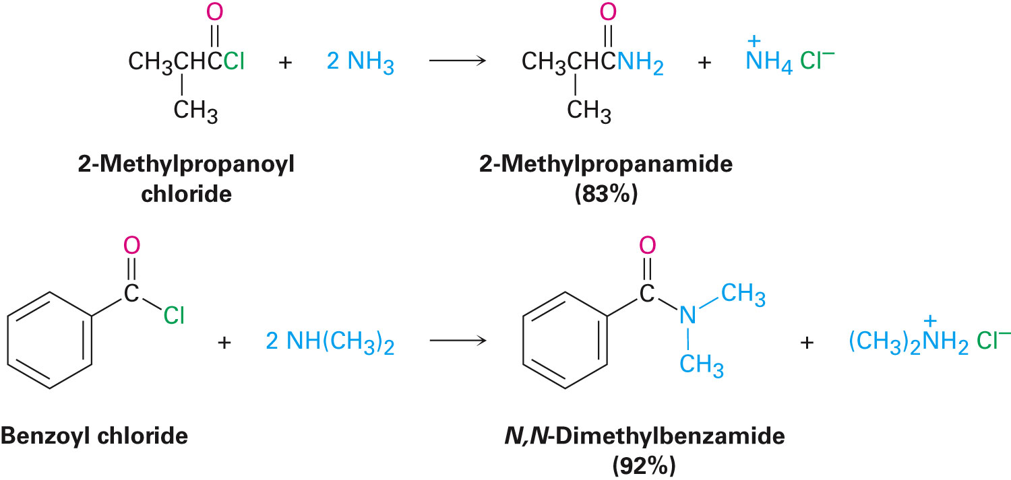
Chemistry of Acid Halides
Aminolysis
Conversion of acid halides into amides acid chloride-plus-alcohol method is used to prepare esters
Method is used in preparation of amines
Trisubstituted amines(R₃N) cannot be used
Notes:
Chemistry of acid halides

Slide 41
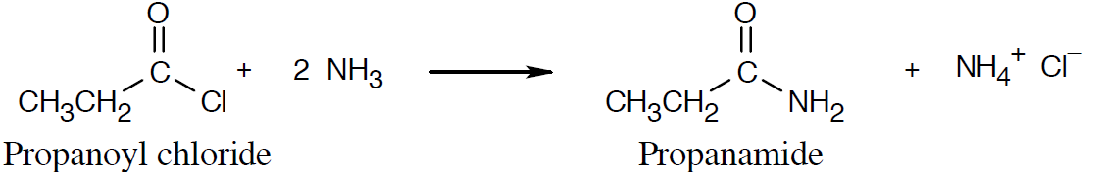
Worked Example
How is propanamide prepared using an acid chloride and an amine or ammonia
Solution:
Notes:
Chemistry of acid halides

Slide 42
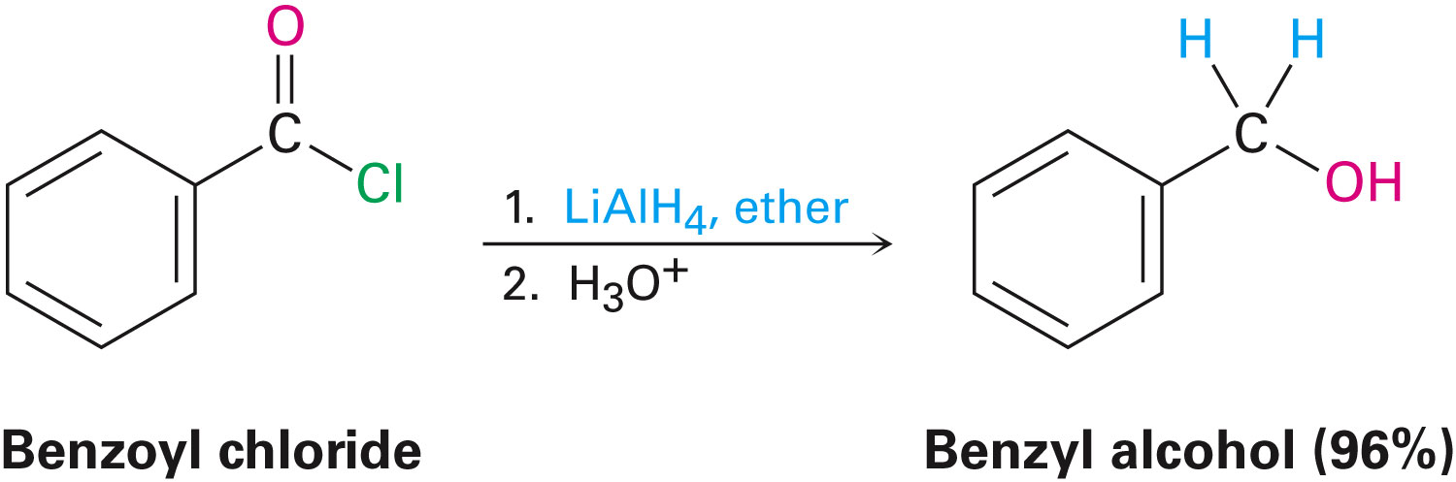
Chemistry of Acid Halides
Conversion of acid chlorides into alcohols: Reduction and Grignard reaction
LiAlH₄ reduces acid chlorides to yield aldehydes and then primary alcohols
Reduction occurs via nucleophilic acyl substitution mechanism
Notes:
Chemistry of acid halides

Slide 43
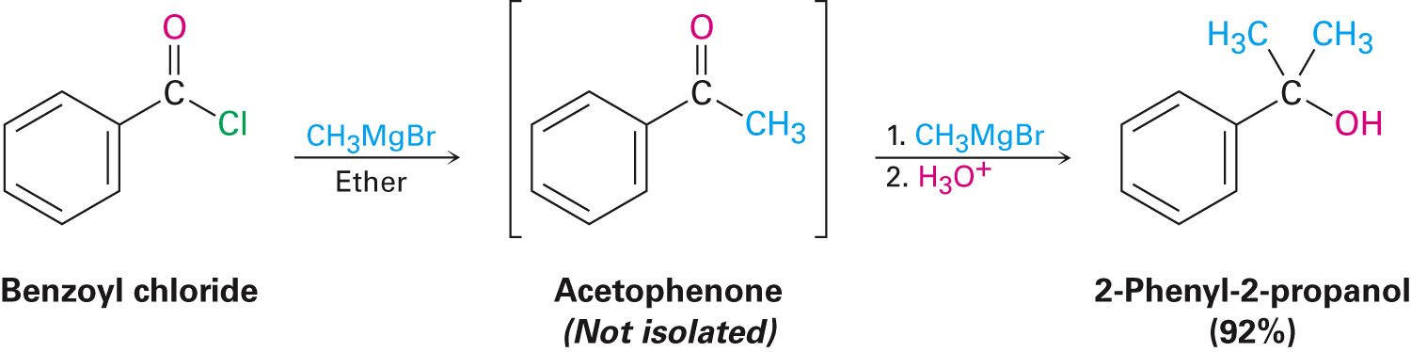
Chemistry of Acid Halides
Grignard reagents react with acid chlorides to yield tertiary alcohols with two identical substituent
Reduction occurs via nucleophilic acyl substitution mechanism
Notes:
Chemistry of acid halides

Slide 44
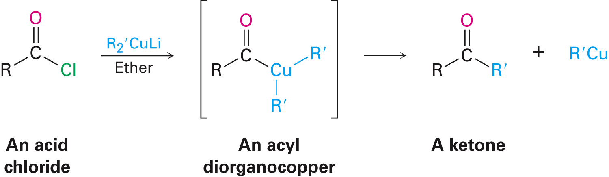
Formation of Ketones from Acid Chlorides
Conversion of acid chlorides into ketones: Diorganocopper reaction
Reaction of an acid chloride with a lithium diorganocopper (Gilman) reagent, Li⁺ R’₂Cu⁻
Addition produces an acyl diorganocopper intermediate, followed by loss of R′Cu and formation of the ketone
Notes:
Chemistry of acid halides

Slide 45
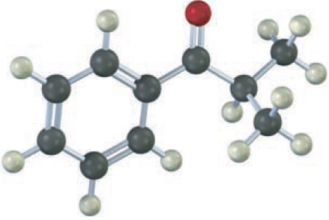
Worked Example
How is the following ketone prepared by reaction of an acid chloride with a lithium diorganocopper reagent?
Notes:
Chemistry of acid halides

Slide 46
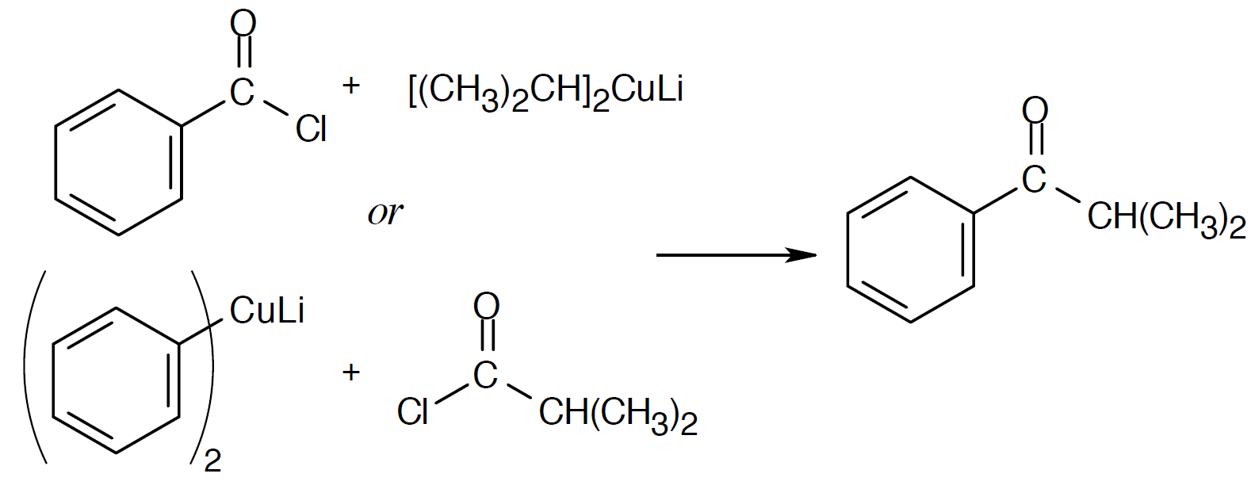
Worked Example
Solution:
Notes:
Chemistry of acid halides

Slide 47
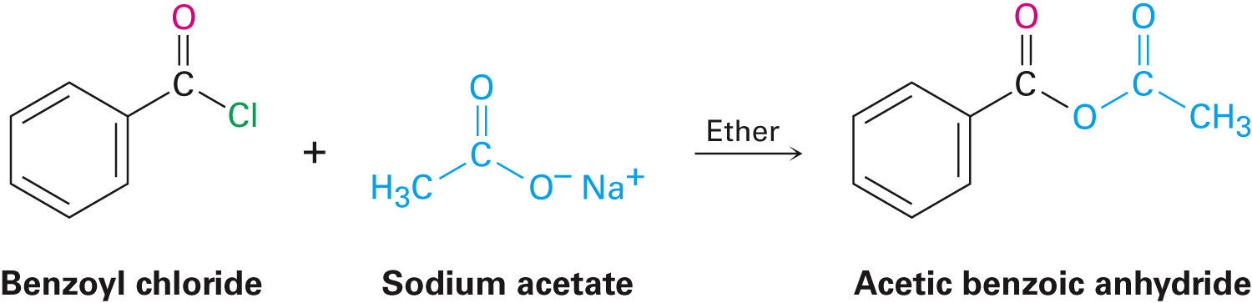
Chemistry of Acid Anhydrides
Preparation of acid anhydrides
Nucleophilic acyl substitution of a carboxylate with an acid chloride
Notes:
Chemistry of acid anhydrides

Slide 48
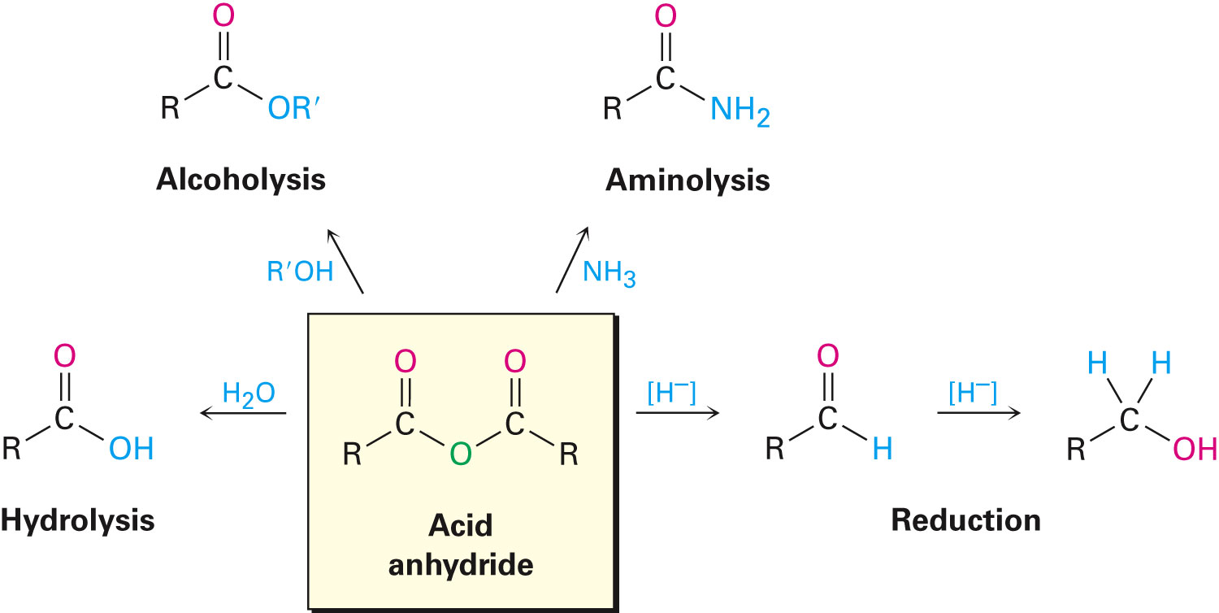
Reactions of Acid Anhydrides
Notes:
Chemistry of acid anhydrides

Slide 49
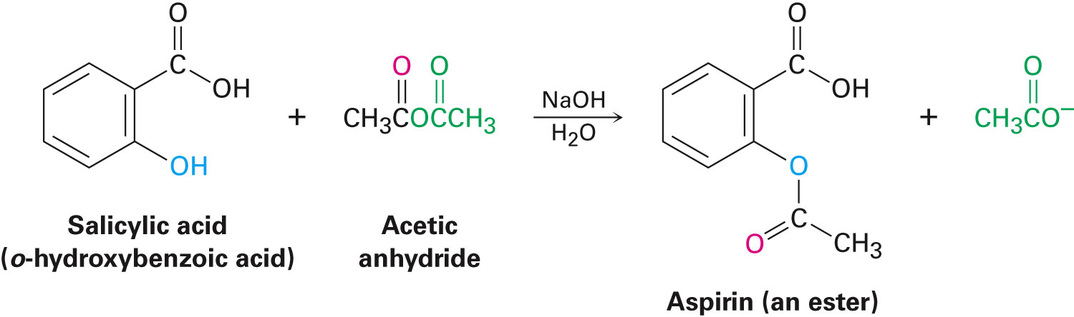
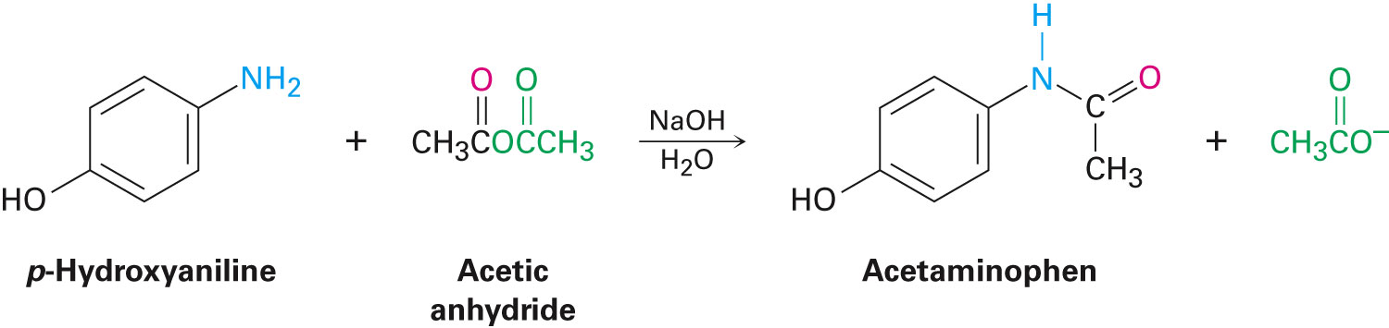
Reactions of Acid Anhydrides
Conversion of acid anhydrides into esters
Acetic anhydride forms acetate esters from alcohols
Conversion of acid anhydrides into amides
Acetic anhydride is used to prepare N-substituted acetamides from amines
Notes:
Chemistry of acid anhydrides

Slide 50
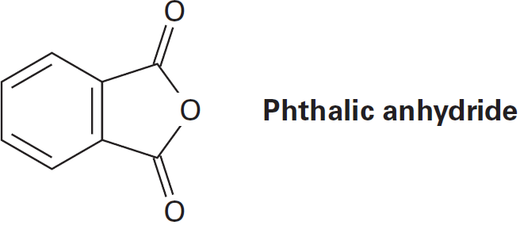
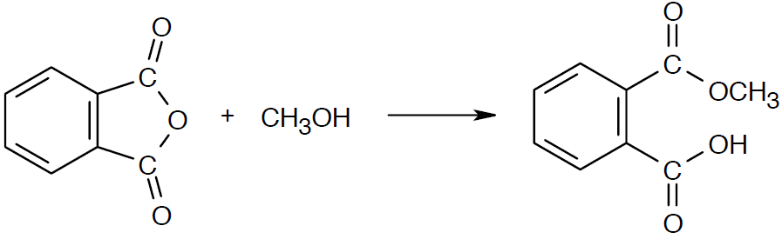
Worked Example
What product is expected from reaction of one equivalent of methanol with a cyclic anhydride, such as phthalic anhydride (1,2-benzenedicarboxylic anhydride)?
Solution:
Notes:
Chemistry of acid anhydrides

Slide 51
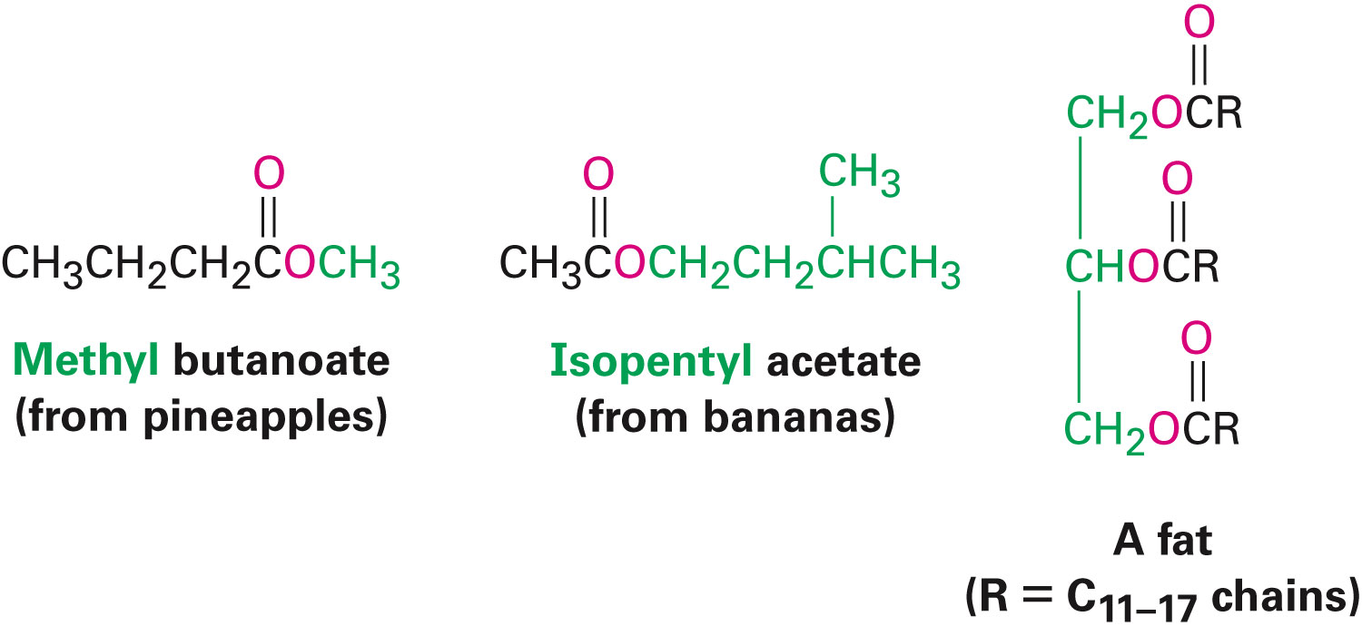
Chemistry of Esters
Esters are pleasant-smelling liquids
Fragrant odors of fruits and flowers
Also present in fats and vegetable oils
Industrially used esters include:
Ethyl acetate
Dialkyl phthalates
Notes:
Chemistry of esters

Slide 52

Chemistry of Esters
Preparation of esters
Esters are usually prepared from carboxylic acids
Acid chlorides are converted into esters by treatment with an alcohol in the presence of base
Notes:
Chemistry of esters

Slide 53
Chemistry of Esters
Reactions of Esters
Less reactive toward nucleophiles as compared to acid chlorides or anhydrides
Cyclic esters are called lactones and react similarly to acyclic esters
Notes:
Chemistry of esters

Slide 54

Chemistry of Esters
Conversion of esters into carboxylic acids: Hydrolysis
An ester is hydrolyzed by aqueous base or aqueous acid to yield a carboxylic acid plus an alcohol
Saponification: Ester hydrolysis in basic solution
Notes:
Chemistry of esters

Slide 55

Figure 21.7 - Mechanism of Base-induced Ester Hydrolysis
Notes:
Chemistry of esters

Slide 56

Chemistry of Esters
Hydrolysis: Conversion of esters into carboxylic acids
Acid-catalyzed ester hydrolysis can occur by different mechanisms
Depends on the structure of the ester
Notes:
Chemistry of esters

Slide 57


Chemistry of Esters
Conversion of esters into amides: Aminolysis
Ammonia reacts with esters to form amides
Conversion of esters into alcohols: Reduction
Reaction with LiAlH₄ yields primary alcohols
Notes:
Chemistry of esters

Slide 58

Chemistry of Esters
Hydride ion adds to the carbonyl group, followed by elimination of alkoxide ion to yield an aldehyde
Reduction of the aldehyde gives the primary alcohol
Aldehyde intermediate can be isolated if 1 equivalent of diisobutylaluminum hydride (DIBAH, or DIBAL-H) is used as reducing agent
Notes:
Chemistry of esters

Slide 59


Worked Example
Show the products that would be obtained by reduction of the following ester with LiAlH₄:
Solution:
Notes:
Chemistry of esters

Slide 60

Chemistry of Esters
Conversion of esters into alcohols: Grignard reaction
Esters react with two equivalents of a Grignard reagent to yield a tertiary alcohol
Notes:
Chemistry of esters

Slide 61

Worked Example
What ester and what Grignard reagent might be required to prepare the alcohol given below?
Notes:
Chemistry of esters

Slide 62

Worked Example
Solution:
Grignard reagents can only be used with esters to form a tertiary alcohol that has two identical substituents
Notes:
Chemistry of esters

Slide 63

Chemistry of Amides
Amides are abundant in living organisms
Proteins, nucleic acids, and other pharmaceuticals have amide functional groups
Amides are the least reactive of the common acid derivative
Notes:
Chemistry of amides

Slide 64

Preparation of Amides
Chemistry of amides
Prepared by reaction of an acid chloride with ammonia, monosubstituted amines, or disubstituted amines
Notes:
Chemistry of amides

Slide 65

Reactions of Amides
Conversion of amides into carboxylic acids: Hydrolysis
Heating in either aqueous acid or aqueous base produces a carboxylic acid and amine
Acidic hydrolysis by nucleophilic addition of water to the protonated amide, followed by loss of ammonia
Notes:
Chemistry of amides

Slide 66

Reactions of Amides
Hydrolysis is difficult in comparison to analogous acid-catalyzed reaction because amide ion is a very poor leaving group
Addition of hydroxide and loss of amide ion
In biological chemistry, amide hydrolysis is common
Notes:
Chemistry of amides

Slide 67

Reactions of Amides
Conversion of amides into amines: Reduction
Reduced by LiAlH₄ to an amine rather than an alcohol
Converts C=O → CH₂
Notes:
Chemistry of amides

Slide 68


Reactions of Amides
Addition of hydride to carbonyl group
Loss of the oxygen as an aluminate anion to give an iminium ion intermediate which is reduced to the amine
The reaction is effective with both acyclic and cyclic amides, or lactams
Good route for preparing cyclic amines
Notes:
Chemistry of amides

Slide 69

Worked Example
How can N-ethylbenzamide be converted into benzoic acid?
Solution:
Notes:
Chemistry of amides

Slide 70

Chemistry of Thioesters and Acyl Phosphates: Biological Carboxylic Acid Derivatives
Nucleophilic carboxyl substitution in nature often involves a thioester or acyl phosphate
Acyl CoA’s are most common thioesters in nature
Notes:
Chemistry of thioesters and acyl phosphates: Biological carboxylic acid derivatives

Slide 71

Worked Example
Write the mechanism of the reaction shown between coenzyme A and acetyl adenylate to give acetyl CoA
Notes:
Chemistry of thioesters and acyl phosphates: Biological carboxylic acid derivatives

Slide 72

Worked Example
Solution:
Since this problem only concerns the –SH group, the remainder of the structure is represented as “R”
Notes:
Chemistry of thioesters and acyl phosphates: Biological carboxylic acid derivatives

Slide 73
Worked Example
Step 1
Nucleophilic addition of the –SR group of CoA to acetyl adenylate to form a tetrahedral intermediate
Step 2
Loss of adenosine monophosphate
Notes:
Chemistry of thioesters and acyl phosphates: Biological carboxylic acid derivatives

Slide 74

Polyamides and Polyesters: Step-Growth Polymers
Reactions occur in distinct linear steps, not as chain reactions
Reaction of a diamine and a diacid chloride gives an ongoing cycle that produces a polyamide
A diol reacting with a diacid leads to a polyester
Notes:
Polyamides and polyesters: Step-growth polymers

Slide 75
Polyamides and Polyesters: Step-Growth Polymers
Main classes of synthetic polymers are:
Chain-growth polymers - Produced in chain-reaction processes
Step-growth polymers: Each bond in the polymer is independently formed in a discrete step
Key bond-forming step is often a nucleophilic acyl substitution of a carboxylic acid derivative
Notes:
Polyamides and polyesters: Step-growth polymers

Slide 76

Polyamides and Polyesters: Step-Growth Polymers
Polyamides (Nylons)
Heating a diamine with a diacid produces a polyamide called nylon
Example - Nylon 66 is prepared from adipic acid and hexamethylene-diamine at 280°C
Used in engineering applications and in making fibers
Notes:
Polyamides and polyesters: Step-growth polymers

Slide 77

Polyamides and Polyesters: Step-Growth Polymers
Polyesters
Most useful type made by reaction between dimethyl terephthalate and ethylene glycol
Tensile strength of poly(ethylene terephthalate) film is nearly equal to that of steel
Notes:
Polyamides and polyesters: Step-growth polymers

Slide 78

Polyamides and Polyesters: Step-Growth Polymers
Sutures and biodegradable polymers
Common biodegradable polymers include:
Poly(glycolic acid) (PGA)
Poly(lactic acid) (PLA)
Poly(hydroxybutyrate) (PHB)
Susceptible to hydrolysis of their ester links
Notes:
Polyamides and polyesters: Step-growth polymers

Slide 79

Worked Example
Draw structures of the step-growth polymers expected from the following reaction:
Solution:
Notes:
Polyamides and polyesters: Step-growth polymers

Slide 80
Spectroscopy of Carboxylic Acid Derivatives
Infrared spectroscopy
Acid chlorides absorb near 1810 cm⁻¹
Acid anhydrides absorb at 1820 cm⁻¹ and also at 1760 cm⁻¹
Esters absorb at 1735 cm⁻¹, higher than aldehydes or ketones
Amides absorb near the low end of the carbonyl region
Notes:
Spectroscopy of carboxylic acid derivatives

Slide 81
Worked Example
What kinds of functional groups might compounds have if they show the following IR absorptions?
a) Absorption at 1735 cm^{–1}
b) Absorption at 1810 cm^{–1}
Solution:
Absorption | Functional group present
1735 cm^{–1}
1810 cm^{–1}
Saturated ester or 6-membered ring lactone
Saturated acid chloride
Notes:
Spectroscopy of carboxylic acid derivatives

Slide 82

Nuclear Magnetic Resonance Spectroscopy
Hydrogens on the carbon next to a C=O are near 2 δ in the¹H NMR spectrum
Acid derivatives absorb in the same range so NMR does not distinguish them from each other
Notes:
Spectroscopy of carboxylic acid derivatives

Slide 83

¹³C NMR
Useful for determining the presence or absence of a carbonyl group in a molecule of unknown structure
Carbonyl carbon atoms of the various acid derivatives absorb from 160 δ to 180 δ
Notes:
Spectroscopy of carboxylic acid derivatives

Slide 84
Summary
Carboxylic acid derivatives are compounds in which the –OH group of a carboxylic acid has been replaced by another substituent
Acid halides, acid anhydrides, esters, and amides are the most common
Thioesters and acyl phosphates are common in biological molecules
Nucleophilic acyl substitution reaction dominates the chemistry of carboxylic acid derivatives
Step-growth polymers are prepared by reactions between difunctional molecules

